Slide 1

First CPP Program
19CSE201 Advanced Programming
Lecture 1

Slide 2
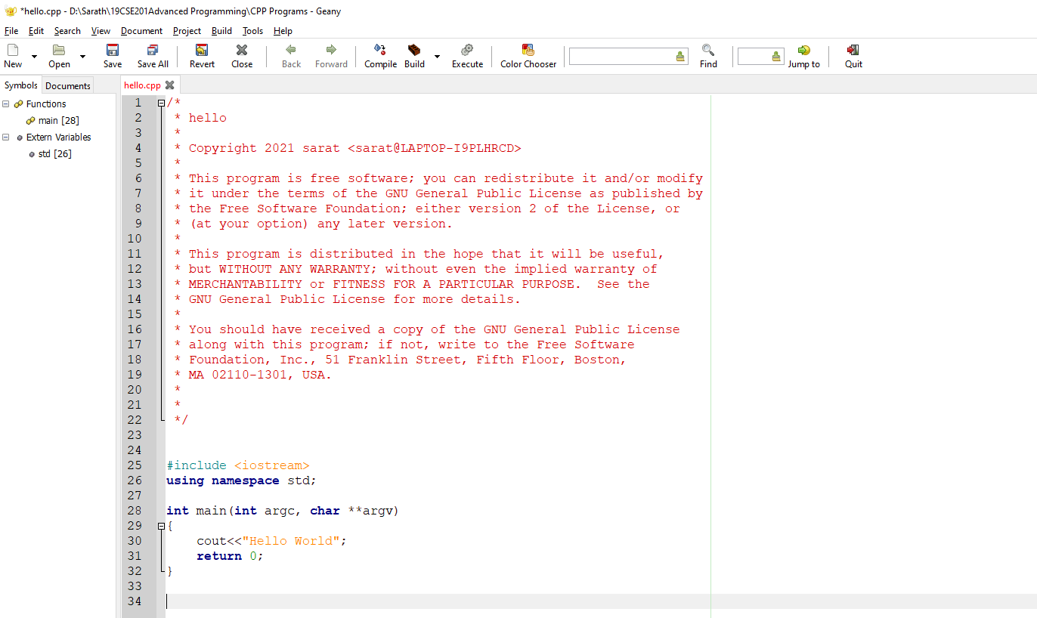
First CPP program

Slide 3
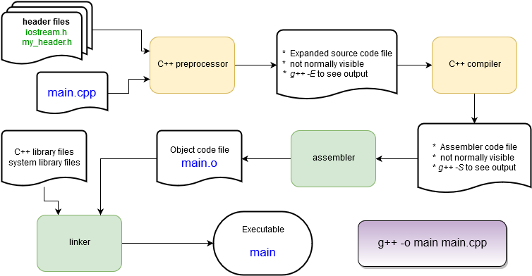
Behind the Scenes: The Compilation Process

Slide 4
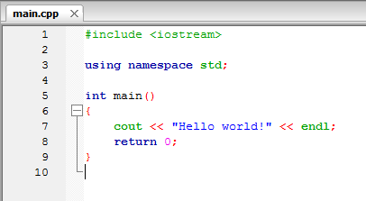
Hello, World! explained
The main routine – the start of every C++ program! It returns an integer value to the operating system and (in this case) takes no arguments: main()
The return statement returns an integer value to the operating system after completion. 0 means “no error”. C++ programs must return an integer value.

Slide 5
Hello, World! explained
loads a header file containing function and class definitions
Loads a namespace called std. Namespaces are used to separate sections of code for programmer convenience. To save typing we’ll always use this line in this tutorial.
cout is the object that writes to the stdout device, i.e. the console window.
It is part of the C++ standard library.
Without the “using namespace std;” line this would have been called as std::cout. It is defined in the iostream header file.
<< is the C++ insertion operator. It is used to pass characters from the right to the object on the left. endl is the C++ newline character.

Slide 6
Header Files
C++ language headers aren’t referred to with the .h suffix. <iostream> provides definitions for I/O functions, including the cout function.
C++ (along with C) uses header files as to hold definitions for the compiler to use while compiling.
A source file (file.cpp) contains the code that is compiled into an object file (file.o).
The header (file.h) is used to tell the compiler what to expect when it assembles the program in the linking stage from the object files.
Source files and header files can refer to any number of other header files.
#include <iostream>
using namespace std;
int main()
{
string hello = "Hello";
string world = "world!";
string msg = hello + " " + world ;
cout << msg << endl;
msg[0] = 'h';
cout << msg << endl;
return 0;
}

Slide 7
Slight change
Let’s put the message into some variables of type string and print some numbers.
Things to note:
Strings can be concatenated with a + operator.
No messing with null terminators or strcat() as in C
Some string notes:
Access a string character by brackets or function:
msg[0] → “H” or msg.at(0) → “H”
C++ strings are mutable – they can be changed in place.
#include <iostream>
using namespace std;
int main()
{
string hello = "Hello";
string world = "world!";
string msg = hello + " " + world ;
cout << msg << endl;
msg[0] = 'h';
cout << msg << endl;
return 0;
}

Slide 8
A first C++ class: string
string is not a basic type (more on those later), it is a class.
string hello creates an instance of a string called “hello”.
hello is an object.
Remember that a class defines some data and a set of functions (methods) that operate on that data.
#include <iostream>
using namespace std;
int main()
{
string hello = "Hello";
string world = "world!";
string msg = hello + " " + world ;
cout << msg << endl;
msg[0] = 'h';
cout << msg << endl;
return 0;
}

Slide 9
A first C++ class: string
From the point of view of main(), the msg object has hidden away its means of tracking and retrieving the number of characters stored.
Note: while the string class has a huge number of methods your typical C++ class has far fewer!
#include <iostream>
using namespace std;
int main()
{
string hello = "Hello" ;
string world = "world!" ;
string msg = hello + " " + world ;
cout << msg << endl ;
msg[0] = 'h';
cout << msg << endl ;
cout << msg.size() << endl ;
return 0;
}
Note that cout prints integers without any modification!

